Slide 1
Digital Objects – towards implementation the CLARIN use cases
Dieter Van Uytvanck and Koenraad De Smedt
GEDE Convergence Meeting on DOA
October 28, 2019
Observatoire de Paris

Slide 2
CLARIN
Common Language Resources and Technology Infrastructure
ESFRI ERIC status since 2012, Landmark since 2016
provides easy and sustainable access for scholars in the humanities and social sciences and beyond
to digital language data
in written, spoken, video or multimodal form
to advanced tools
to discover, explore, exploit, annotate, analyse or combine them, wherever they are located
through a single sign-on online environment
distributed services at about 50 centres

Slide 3
CLARIN ERIC

Slide 4
Data architecture at a CLARIN centre
Repository at a CLARIN centre
Single text or recording
Corpus
Lexicon
Wordnet
Grammar
...
Language Data
Metadata
Language Tools
Web application
Web service
Web service pipeline
Stand-alone application
...
describes

Slide 5
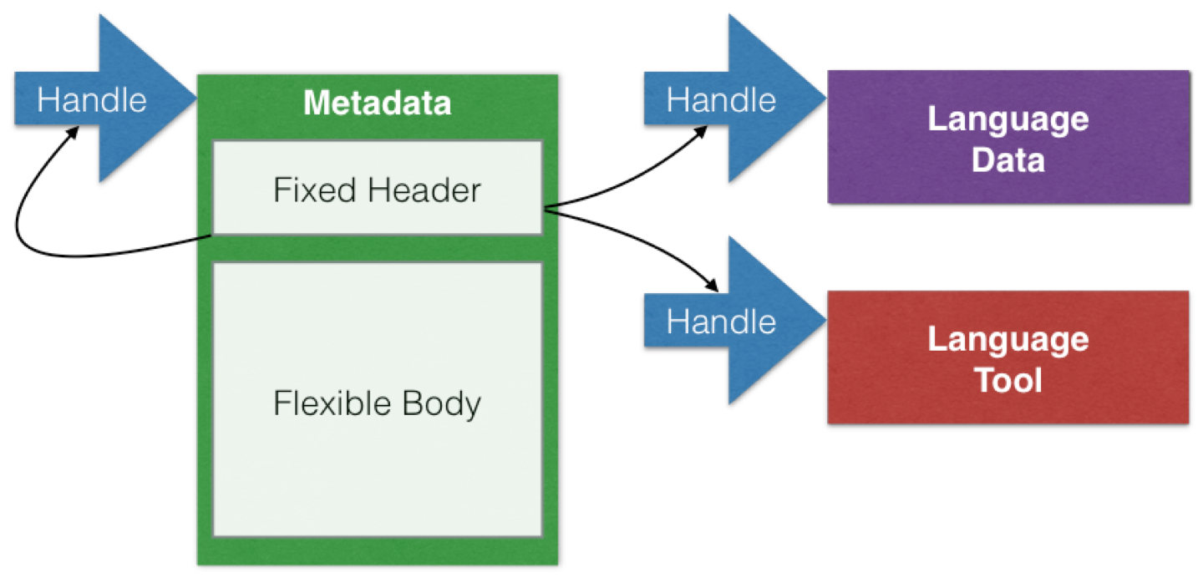
The CLARIN data architecture:
Persistent Identifiers (PIDs)

Slide 6
Metadata type registry
CMDI component and profile registry https://catalog.clarin.eu/ds/ComponentRegistry/ metadata profiles and their components are not the same as data object types, but it is useful to look at their organization

Slide 7



Data discovery and processing
Language Data
Metadata
Language Tools
Language Data
Metadata
Language Tools
Harvested Metadata
Metadata Search
Data Analysis
Indexation
Selection
Language Data
Metadata
Language Tools
Language Data
Metadata
Language Tools

Slide 8
Language Resource Switchboard (switchboard.clarin.eu and clarin.eu/eosc)
Match based on language, format & task
Language Data
Language Tools
Language Resource Switchboard
Language Data
Language Tools
Language Data
Language Tools
Language Data
Language Tools

Slide 9
Tool metadata in LR Switchboard

Slide 10
LR Switchboard inputs
Language Data
Language Resource Switchboard
Language Tools
CLARIN & EOSC-hub
Via metadata
Virtual Language Observatory
Virtual Collection Registry
EUDAT
Via metadata
B2DROP
[cloud storage]
Parthenos
Via metadata
D4Science
[Virtual Research Environment]
C2CAMP/GEDE-DO
Via direct input of digital objects
Matching based on mime type and language information stored in handle

Slide 11
CLARIN Digital Object requirements
PID Kernel Information
Community profile
Persistent Identifier
Metadata Identifier
Mimetype
Language
License?
Language Data
Metadata
text/plain
ISO639-3: nld
GPL v3
Describes

Slide 12
Virtual Collections (collections.clarin.eu)
Digital Object
Collection
Metadata
URL
Metadata
Object
Metadata
Object
PID
Metadata
Object
Digital Object
Referencing object via URL
Object metadata managed by collection owner
Referencing object via PID
Object metadata managed by collection owner
Referencing object via Digital Object Identifier
Object metadata collected via DO protocol

Slide 13
Next steps
Select a DTR [done] > the EPIC one
EPIC: Register an account and create a prototype profile
Register a few example handles and make them full-fledged Digital Objects
Extend the LR Switchboard so that it
can recognize Digital Objects when a handle is provided as input [done: handle support]
https://collections.clarin.eu/app/details/1020
extract relevant metadata from the DO to feed it into the switchboard as parameter
Extend the Virtual Collection Registry
Extend CLARIN DSpace and other platforms/tools

Slide 14
Digital Object Protocol: advantages for CLARIN services
Language Resource Switchboard
Language Data
Metadata
Language Tools
DO Interface
Uniform interface to object:
DO capacities
Bitstream
Descriptive metadata
Community dependent data type
Virtual Collection Registry
DO Interface
Language Data
Metadata
Language Tools
Other services

Slide 15
Summary
CLARIN use cases based on existing services
Language Resource Switchboard
Virtual Collection Registry
These and other services can be extended to deal with DOs
Important DO properties (in part community dependent)
Reference to descriptive / user metadata
Mime Type
Language (for language resources)
License

